Slide 1

Washington State EV Analysis
Group 3
Shreya Arya, Kriti Sundaresa, Flora Zheng, Han Truong, Ashni Kumar
August 2026
Notes:
Shreya

Slide 2
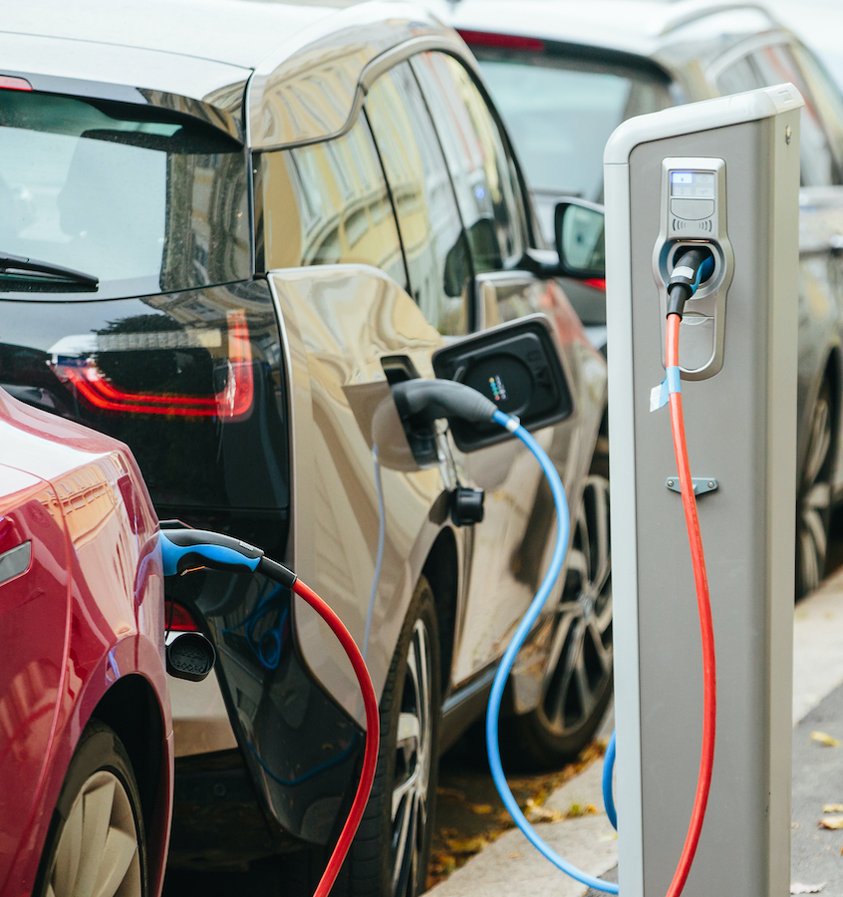
Problem/Why It Matters
EV ownership is growing rapidly, increasing the need for accessible public charging infrastructure
Charging stations may not be distributed proportionally to where EV owners actually live
Areas with many EV registrations but fewer chargers could experience infrastructure gaps
Limited charging access can discourage EV adoption, especially outside major urban/commercial centers
Improving charger placement can support continued EV adoption and help reduce transportation-related emissions
Washington is a useful case study because it has high EV adoption across urban, suburban, and rural communities
Notes:
Shreya

Slide 3
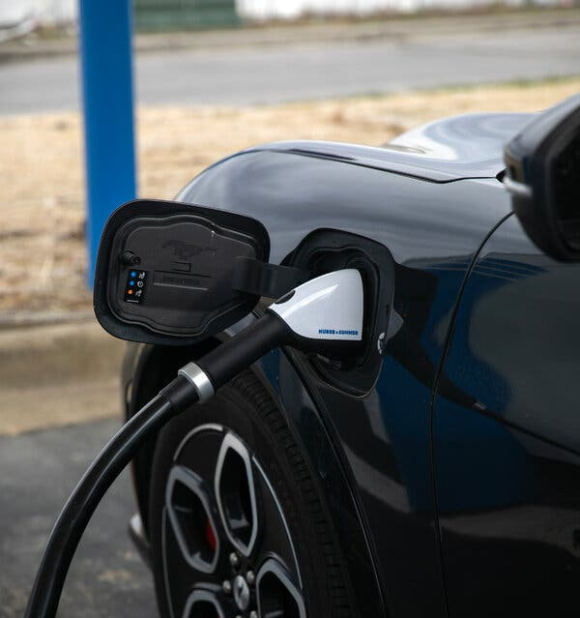
Dataset Overview
Washington State Electric Vehicle Population Dataset
Source: Washington State Department of Licensing
Approximately 289,000 registered electric vehicles in the dataset
Includes both Battery Electric Vehicles (BEVs) and Plug-in Hybrid Electric Vehicles (PHEVs)
Key variables include county, city, ZIP code, model year, make/model, EV type, electric range, and vehicle location
Combined with public EV charging station data to compare EV registrations with charging availability
Analysis was primarily performed at the county level
Notes:
Shreya

Slide 4
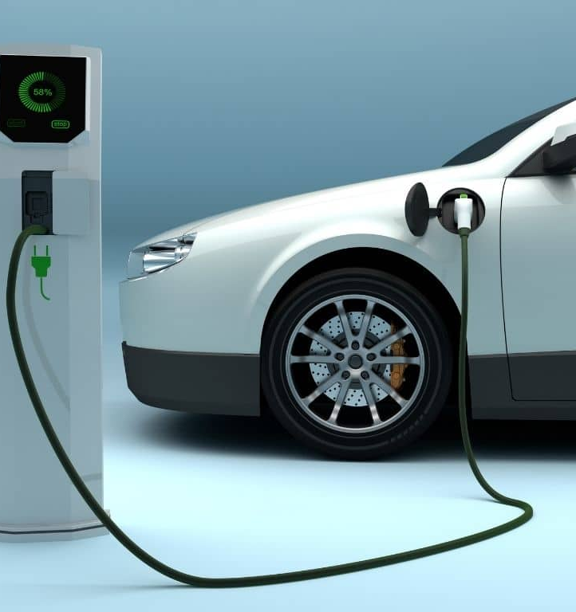
Summary of Results
EV registrations are highly concentrated in a small number of Washington counties
King County has the largest EV population, with about 140,000 registered EVs
Snohomish, Pierce, and Clark Counties also contain large EV populations
EV population and charging station availability have a very strong positive relationship
Regression analysis found R² ≈ 0.98 and p < 0.001, meaning counties with more EVs generally have more charging stations
Facility type did not show a statistically significant relationship with whether an area was high- or low-EV
Some counties still appear underserved relative to their EV populations
Snohomish County had 260 stations compared with about 397 predicted by the model
Notes:
Shreya

Slide 5
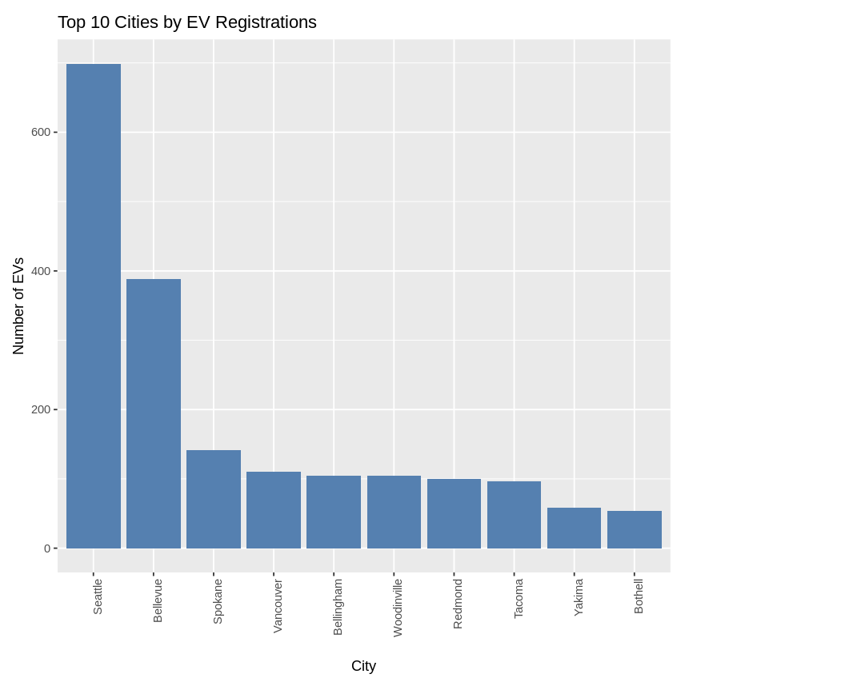
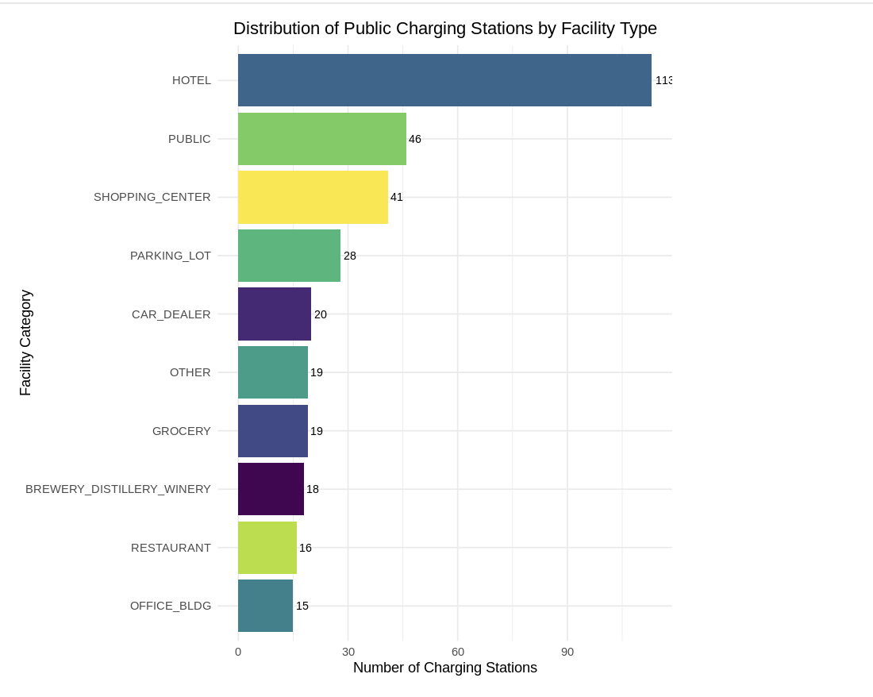
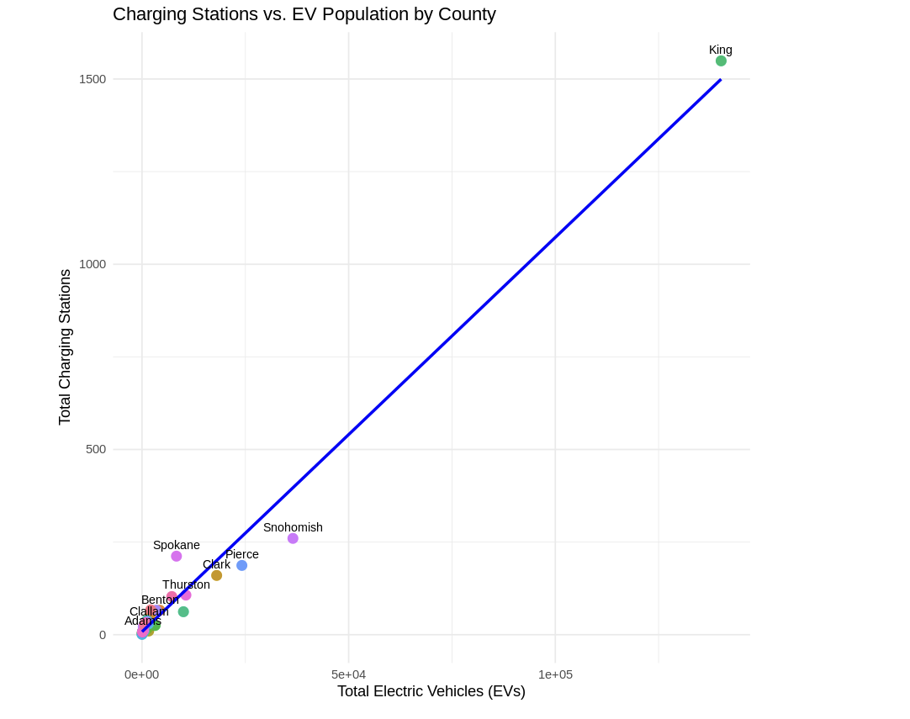
EDA
Notes:
Kriti

Slide 6
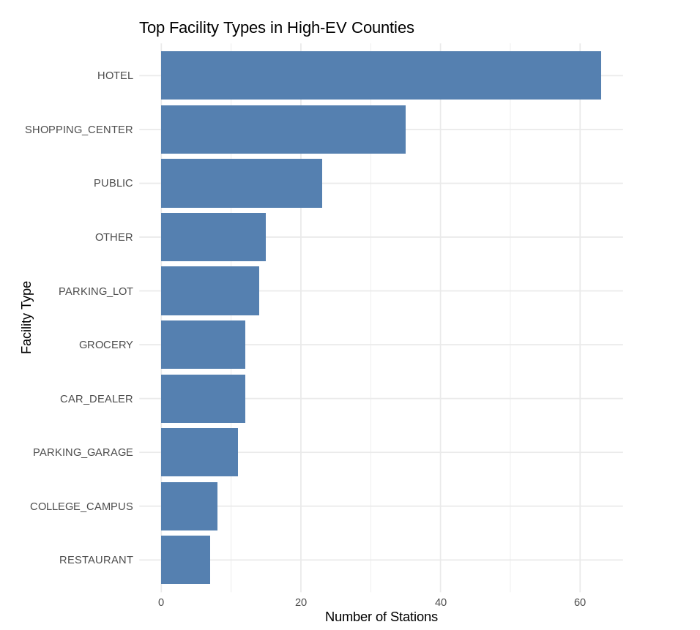
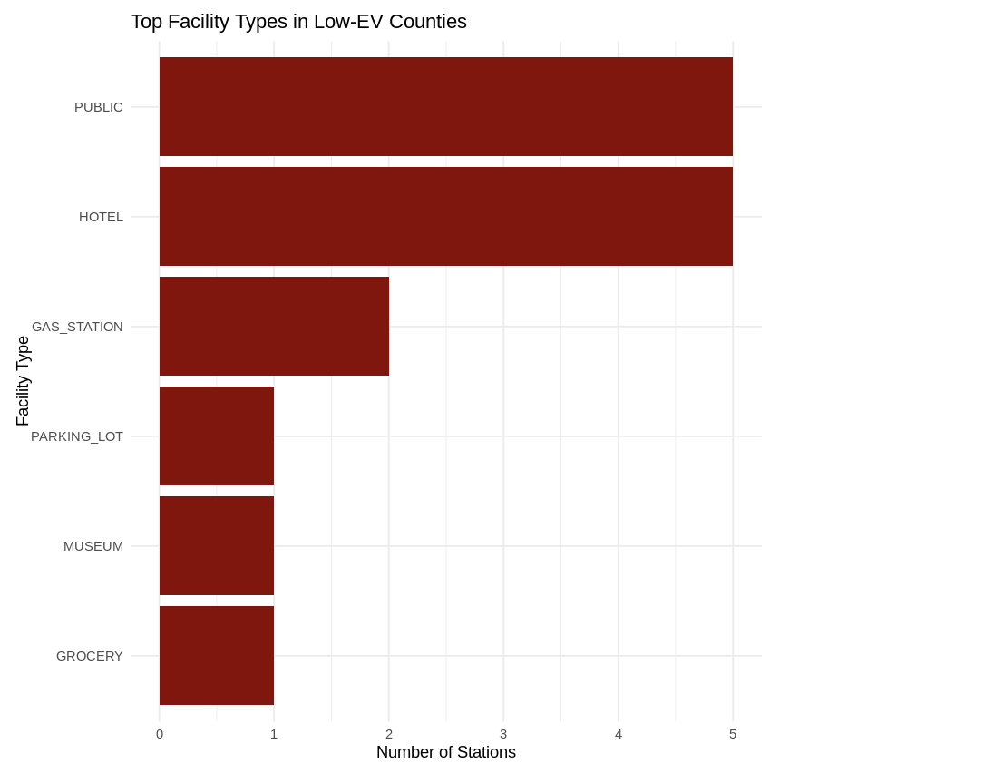
EDA
Notes:
Kriti

Slide 7
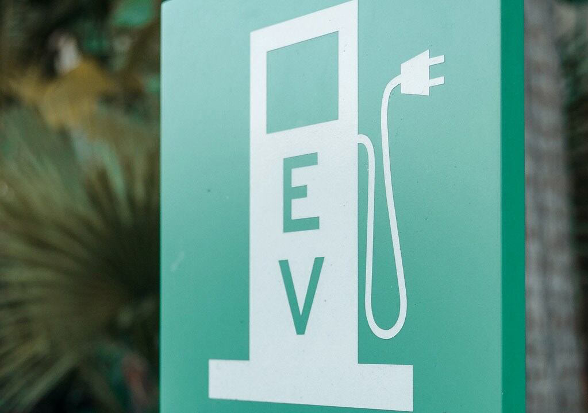
Test 1
Is there a significant positive correlation at 95% confidence level between a county's electric vehicle population and the number of public EV charging stations available in that county?
H0: There is no significant linear relationship between EV Count and Station Count.
H1: There is a significant linear relationship between EV Count and Station Count.
Notes:
Ashni

Slide 8
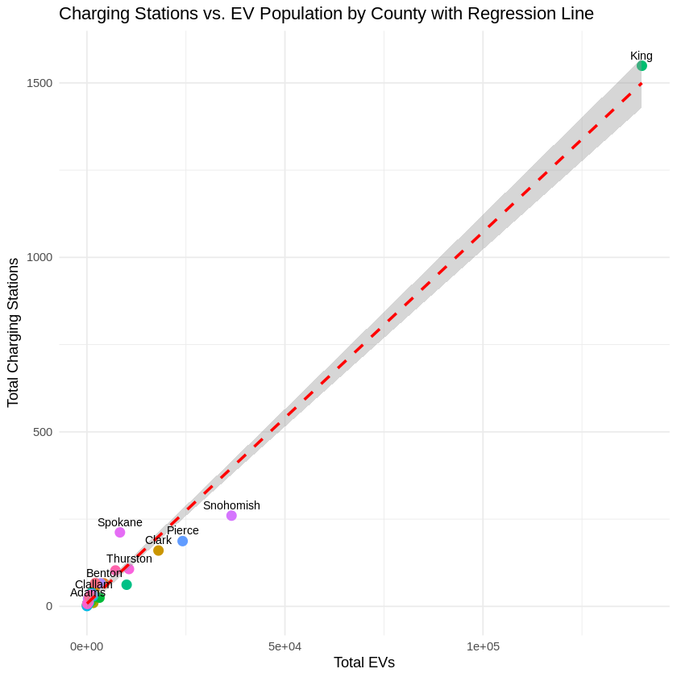
Methodology 1
Simple Linear Regression
Result at 95% confidence level (α = 0.05):
Reject H₀.
There is a statistically significant relationship between the number of EVs and charging stations at each county.
Notes:
Ashni

Slide 9
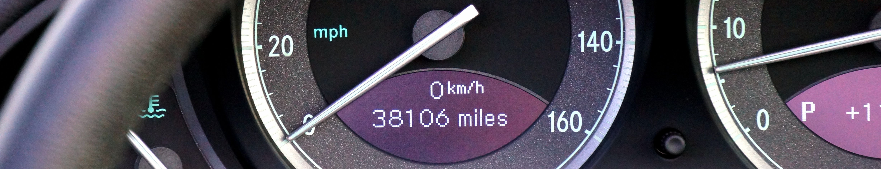
Test 2
Is there a significant positive correlation at 95% confidence level between model year and electric range?
H0: No correlation between model year and electric range.
H1: There is a correlation between model year and electric range.
Notes:
Ashni

Slide 10
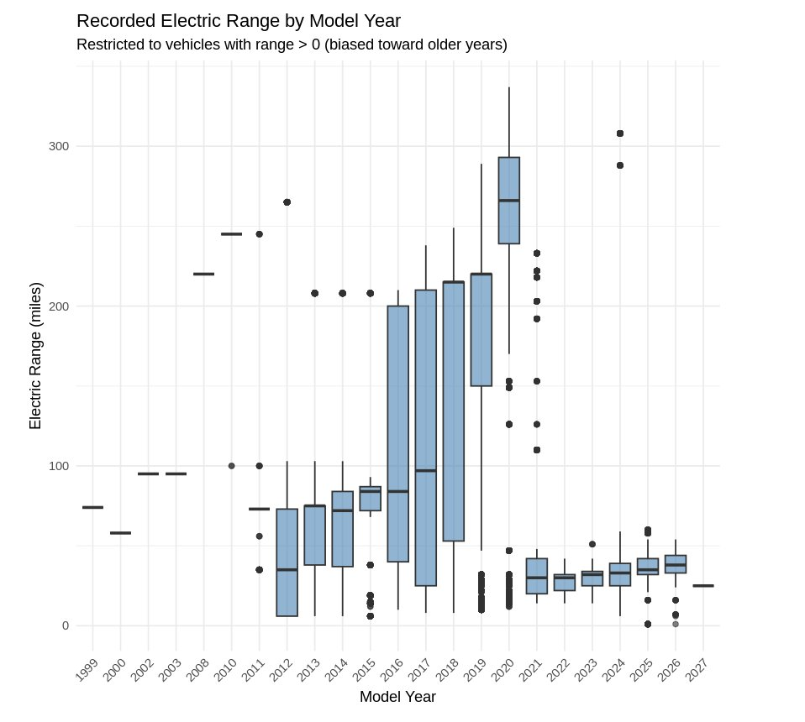
Methodology 2
Spearman correlation
checks whether the two variables tend to increase or decrease together
Pearson correlation
linear relationship check
Result at 95% confidence level (α = 0.05):
Reject H₀. There is a statistically significant relationship between model year and electric range.
Direction: ρ = −0.265, indicating a negative correlation in this dataset.
Notes:
Ashni

Slide 11
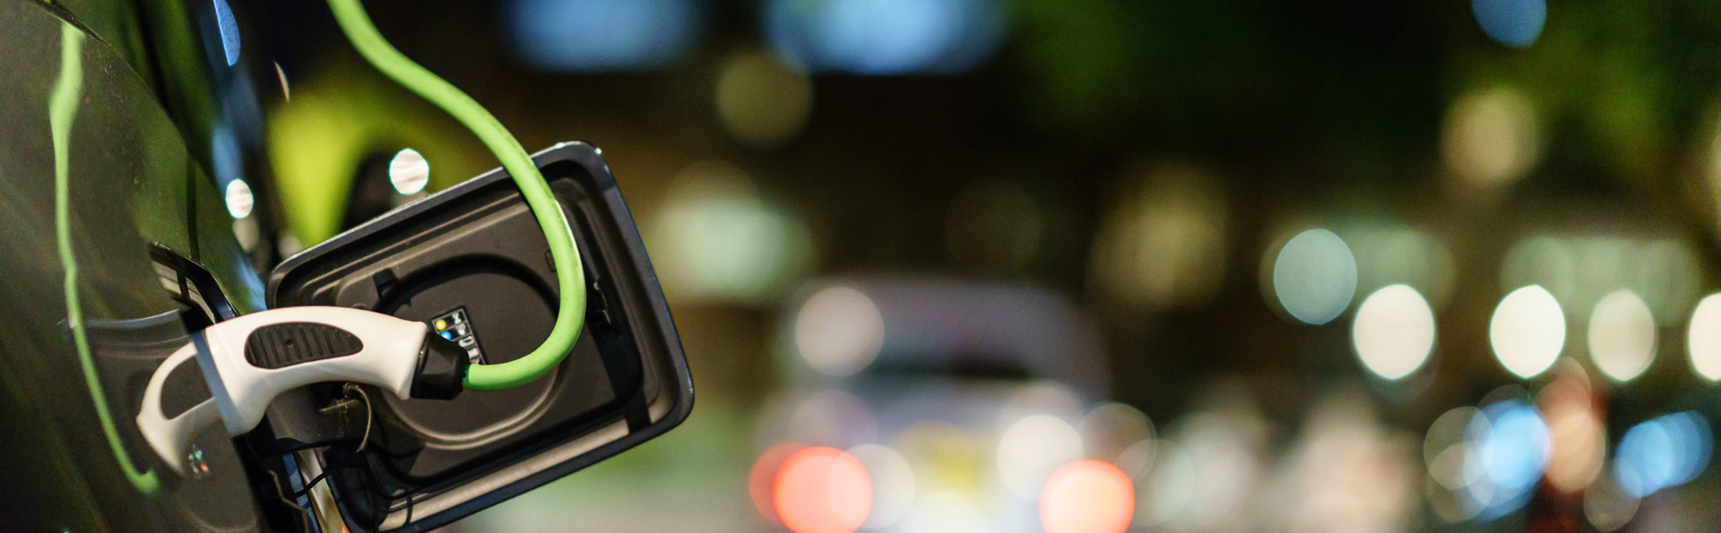
Test 3
Is there a significant positive correlation at 95% confidence level between the distribution of Facility Type and whether a county is a High-EV or Low-EV county
H0: There is no association between facility type and whether a county is High-EV or Low-EV.
H1: There is an association between facility type and whether a county is High-EV or Low-EV.
Notes:
Flora

Slide 12
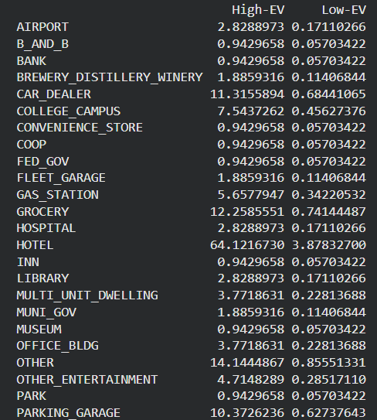
Methodology 3
Chi-Square Test of Independence
checks whether the differences in facility type counts are large enough to indicate a relationship rather than occurring by chance.
Results at 95% confidence level (α = 0.05):
Failed to reject H₀.
No significant association between Facility Type and County Type.
Notes:
Flora

Slide 13
Results
Correlation Between County's EV Population & # of Public EV Charging Stations | Correlation Between Model Year & Electric Range | Correlation Between Distribution of Facility Type & County Being High-EV vs. Low-EV
Reject | Reject | Fail to reject
Notes:
Flora

Slide 14

Thank You!

